Slide 1
PROTEIN FOLDING AND MOLECULAR CHAPERONES
Folding
of Barnase Protein
Notes:
11

Slide 2
PROTEIN FOLDING AND MOLECULAR CHAPERONES
COURSE COORDINATOR:
Dr. Saravanan P
PRESENTED BY:
Prakruthi M
Pragna S
S Varsha
Folding
of Barnase Protein

Slide 3
SYLLABUS

Slide 4
Table of contents
Protein Folding
Molecular Chaperones
Protein Misfolding
Diseases related to protein misfolding

Slide 5
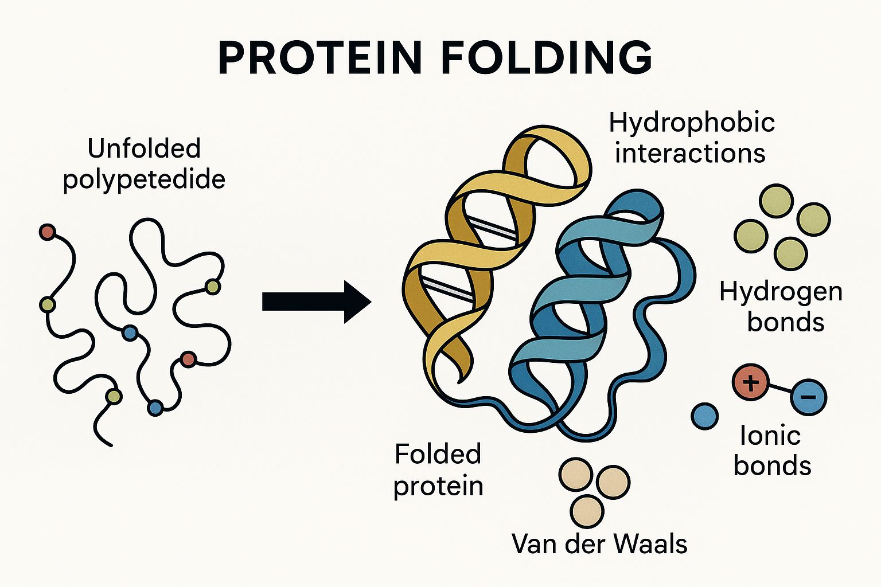
Protein Folding
Protein folding is the biological process by which a linear chain of amino acids (polypeptide) folds into a specific, stable three-dimensional (3D) structure, which is essential for the protein's function.
Folding is driven by interactions between amino acids, such as hydrogen bonding, hydrophobic interactions, and ionic bonds.
The process is often assisted by molecular chaperones in the cell.

Slide 6
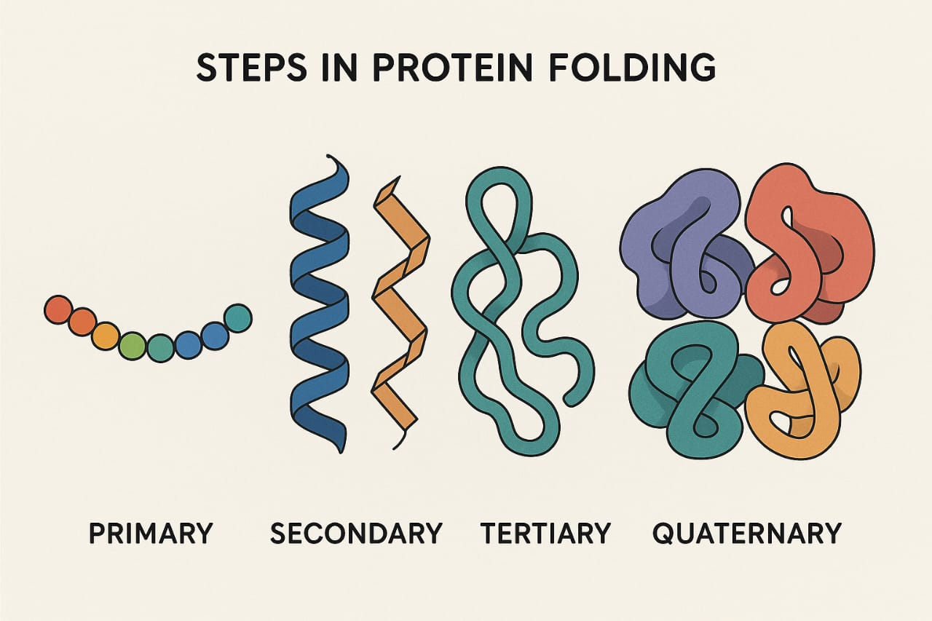
Steps in Protein Folding
1.Primary structure: sequence of amino acids.
2. Secondary structure: alpha-helices and beta-sheets.
3.Tertiary structure: 3D folding due to side chain interactions.
4.Quaternary structure: multiple polypeptides assemble.(eg: Hemoglobin- 4 subunits)

Slide 7
Molecular Chaperones
• Molecular chaperones assist the folding of nascent or stress-denatured proteins.
• Function:
Prevent misfolding and aggregation of polypeptides.
Help refold misfolded proteins.
Assist in protein transport across membranes.
Proteins that assist in the proper folding of other proteins without being part of the final structure.
ATP-dependent: Many chaperones require ATP to function (e.g., Hsp70, Hsp90).
• Examples: Hsp70, Hsp60 (chaperonins), Hsp90, and small heat shock proteins.

Slide 8
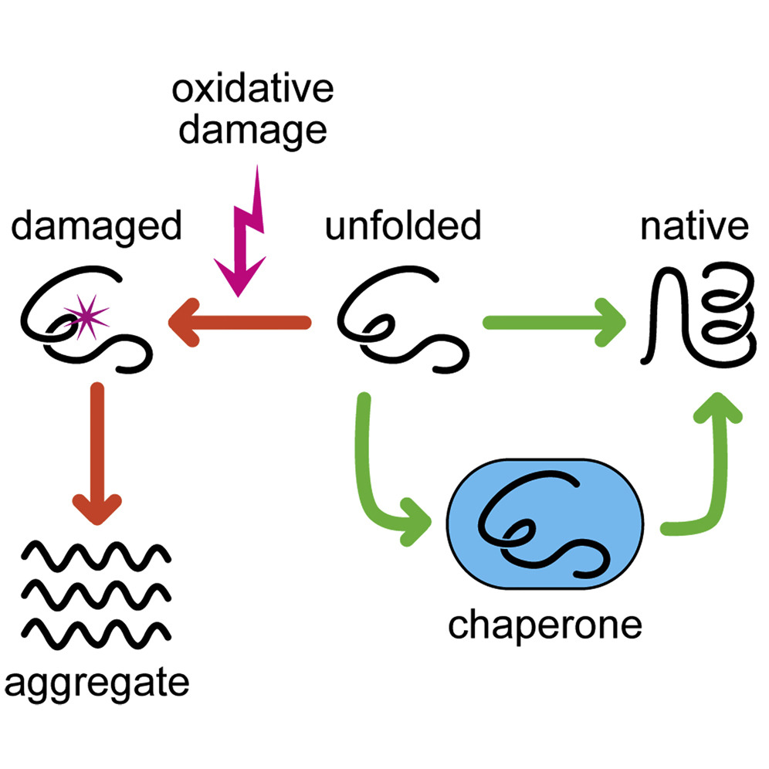
Mechanism of Chaperones
1. Recognition of Unfolded or Misfolded Proteins
Chaperones detect exposed hydrophobic regions on nascent or misfolded polypeptides.
These regions should be buried inside a properly folded protein.
2. Binding to the Substrate Protein
The chaperone binds to the unfolded protein to prevent aggregation and incorrect interactions.
3. ATP Binding and Hydrolysis (for ATP-dependent chaperones)
ATP binding triggers a conformational change in the chaperone.

Slide 9
Mechanism of Chaperones
4. Folding Assistance
The chaperone may hold the substrate in a partially folded state (Hsp70)
5. Release the folded protein
After correct folding, ATP exchange causes release of the substrate.
6. Recycling
The chaperone returns to its original state and is ready for the next cycle.

Slide 10
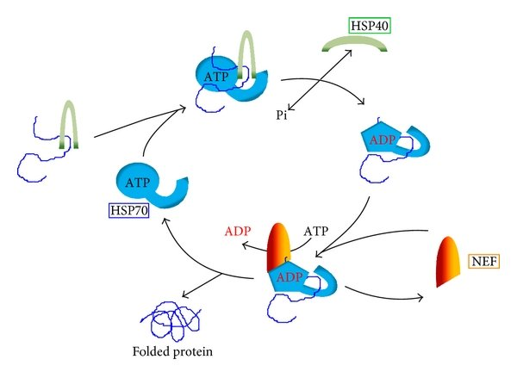
HSP 70 mechanism
An unfolded or misfolded protein (with exposed hydrophobic regions) binds to the substrate-binding domain of Hsp70.
Hsp40 (DnaJ) recognizes the misfolded protein and delivers it to Hsp70.
When ATP is hydrolyzed to ADP, Hsp70 changes shape and closes tightly around the protein.
A nucleotide exchange factor (NEF) helps Hsp70 release ADP and bind a new ATP.
Protein is either folded or goes through another round.

Slide 11
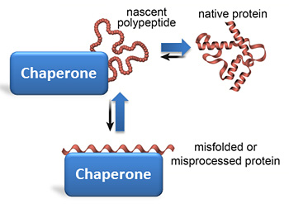
Protein Misfolding
It is the incorrect folding of a protein into a non-functional or harmful structure.
Misfolded proteins fail to achieve their proper 3D conformation.
Causes of Protein Misfolding: genetic mutations, cellular stress, errors in translation.
Consequences of Misfolding:
Loss of biological activity, Formation of toxic aggregates or amyloid fibrils, Triggers cellular stress responses (e.g., unfolded protein response)

Slide 12
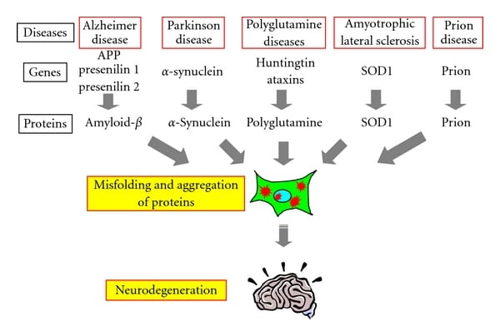
Diseases Related to Protein Misfolding
• Alzheimer's disease – aggregation of amyloid-beta plaques.
• Parkinson's disease – alpha-synuclein aggregates (Lewy bodies).
• Huntington's disease – polyglutamine expansion in huntingtin protein.
• Prion diseases – misfolded prion proteins induce misfolding in normal prions

Slide 13
Therapeutic Approaches
• Use of molecular chaperones or chaperone mimetics.
• Proteostasis regulators to restore protein homeostasis.
• Gene therapy and small molecules to prevent aggregation.
• Immunotherapy targeting toxic protein aggregates.

Slide 14
Conclusion
• Protein folding is essential for functional proteins.
• Molecular chaperones are key players in preventing misfolding.
• Misfolding is implicated in several neurodegenerative diseases.
• Understanding these processes offers potential therapeutic targets.

Slide 15
REVIEW PAPER
Involvement of molecular chaperone in protein misfolding brain diseases

Slide 16
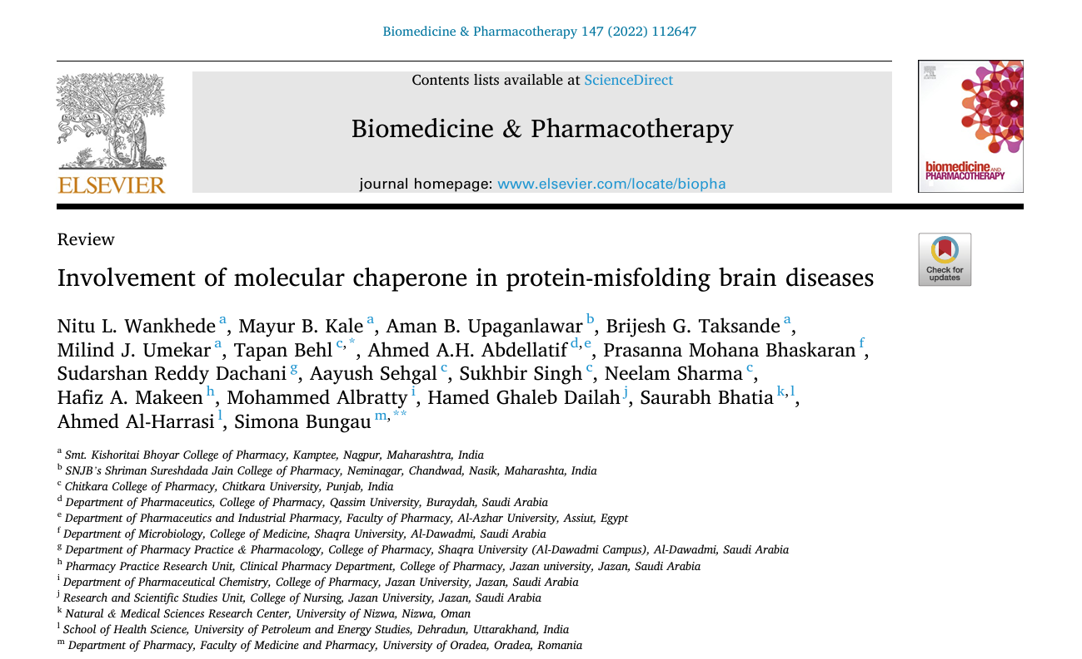

Slide 17
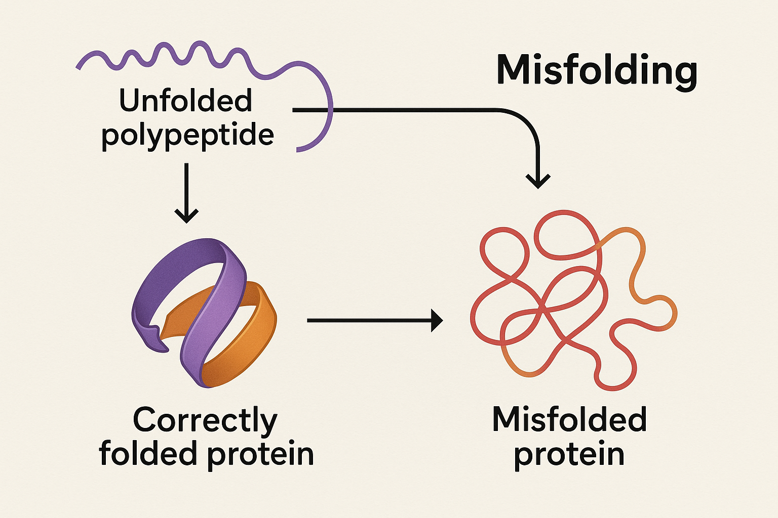
Fundamentals of Protein Folding and Misfolding
Protein Folding
Proteins fold into specific three-dimensional shapes essential for their function. Folding is driven by amino acid sequence and cellular environment.
Protein Misfolding
Misfolded proteins fail to achieve proper conformation, causing loss of function and propensity to aggregate into toxic species.

Slide 18
Protein Quality Control Systems[PQC]
Protein quality control systems are mechanisms that ensure proteins are correctly folded and functional, primarily involving molecular chaperones. These chaperones assist in the proper folding of nascent proteins, refold misfolded proteins, and prevent aggregation, thereby maintaining cellular proteostasis and function.
The Essential components of Protein Quality Control Systems are:
Molecular Chaperones
Proteases
Endoplasmic Reticulum (ER) Quality Control

Slide 19
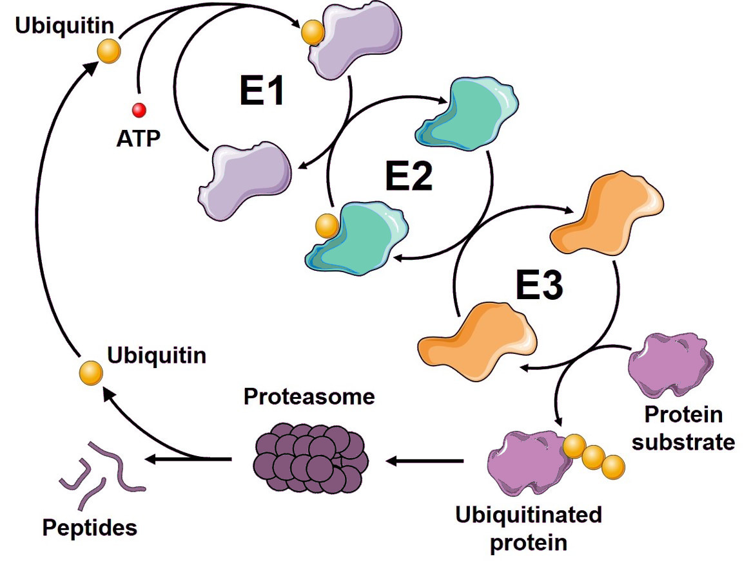
Ubiquitin Proteasome System [UPS]
This plays a crucial role in protein quality control by targeting misfolded proteins for degradation. Molecular chaperones assist in this process by preventing aggregation and facilitating the proper folding of proteins, particularly in the context of neurodegenerative diseases like Parkinson's disease.

Slide 20
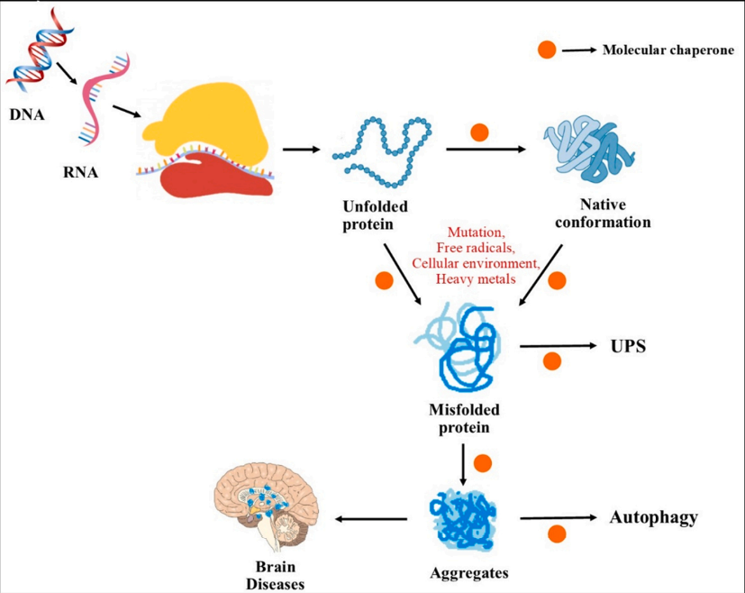
Molecular chaperones
Molecular chaperones are molecules that helps other proteins fold correctly inside the cell. By ensuring that proteins attain the proper three-dimensional structures necessary for their biological activity, they play a critical role in preserving cellular function.

Slide 21
Functions and types of molecular chaperones
Functions:
Chaperons assists in folding of nascent polypeptides
Chaperons prevent aggregation of misfolded proteins
Chaperons refold damaged or stress-denatured proteins

Slide 22
Types of molecular chaperones
Heat shock proteins (Hsp70, Hsp90)
Small heat shock proteins (sHsp)
Chaperonins (GroEL/GroES in bacteria, TRiC in eukaryotes)

Slide 23
Chaperone Dysfunction in Brain Diseases
Chaperon dysfunction causes:
Reduced Chaperone Capacity
Accumulation of Toxic Aggregates
Neuronal Damage and Death
Examples of brain diseases caused by chaperon dysfunction:
Alzheimer's Disease
Parkinson's Disease
Huntington’s Disease

Slide 24
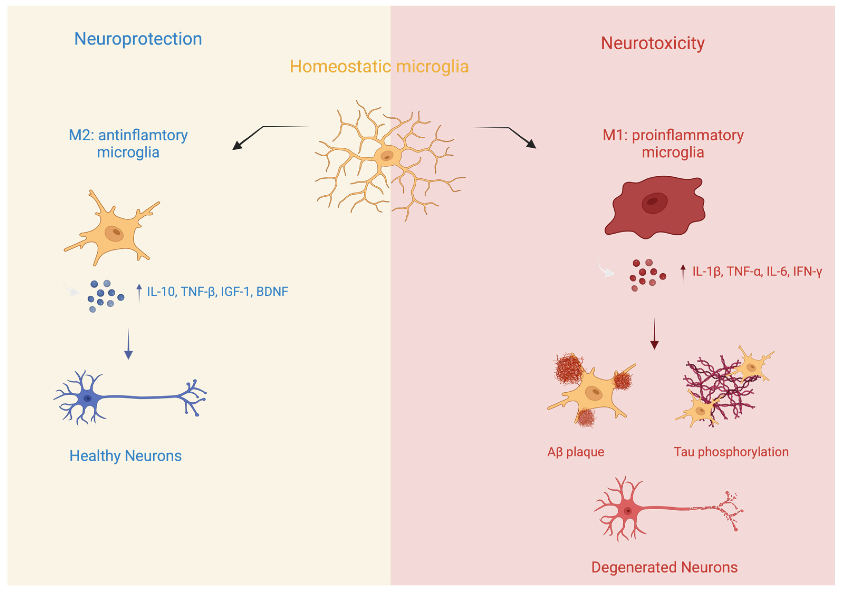
Alzheimer's Disease
Alzheimer’s Disease is a progressive neurodegenerative disorder and the most common cause of dementia. It gradually destroys memory, thinking skills, and eventually the ability to carry out simple tasks.

Slide 25
Chaperone Type | Function in Alzheimer's | Target Protein
Hsp70 | Inhibits amyloid-beta aggregation; promotes clearance | Amyloid-beta (Aβ)
Hsp90 | Regulates tau protein stability; modulates aggregation | Tau [Tubulin Associated Unit]
Small Hsps | Bind misfolded tau; prevent fibril formation | Tau [Tubulin Associated Unit]

Slide 26
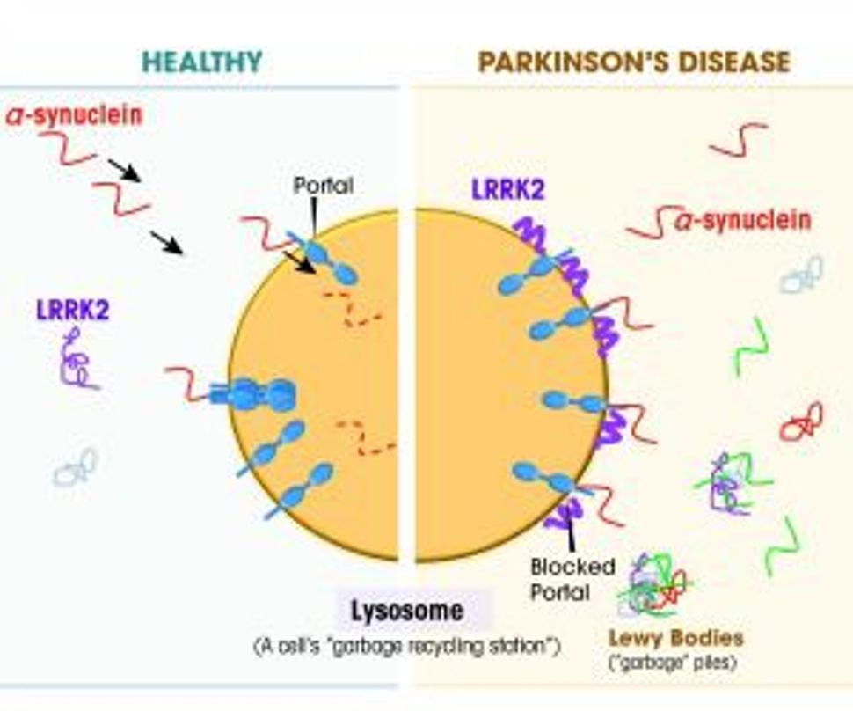
Parkinson's Disease
Parkinson's disease is a progressive movement disorder of the nervous system. It causes nerve cells (neurons) in parts of the brain to weaken, become damaged, and die, leading to symptoms that include problems with movement, tremor, stiffness, and impaired balance.

Slide 27
Chaperone Type | Function in Parkinson's | Target Protein
Hsp70 | Prevents aggregation of α-synuclein and facilitates its refolding or degradation to reduce toxicity. | α-Synuclein
Hsp90 | Regulates stabilization and degradation of proteins; involved in modulating α-synuclein oligomerization and toxicity. | α-Synuclein
Hsp60 (Chaperonin) | Assists mitochondrial protein folding; mitochondrial dysfunction is critical in Parkinson's pathology. | Various mitochondrial proteins

Slide 28
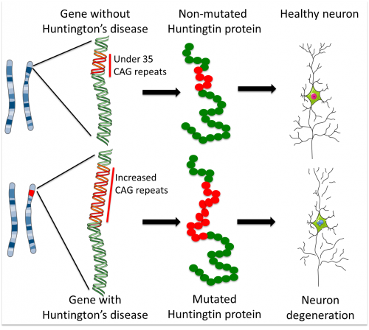
Huntington’s disease
Huntington's disease [HD] is an inherited disorder that causes nerve cells [neurons] in parts of the brain to gradually break down and die. The disease attacks areas of the brain that help to control voluntary [intentional] movement, as well as other areas of the brain.

Slide 29
Chaperone Type | Function in Huntington's | Target Protein
Hsp70 | Inhibits huntingtin aggregation, promotes refolding, and facilitates proteasomal degradation of mutant huntingtin protein. | Mutant Huntingtin (mHTT)
Hsp40 (DNAJ family) | Stimulates Hsp70 ATPase activity and cooperates to suppress aggregation and toxicity of mutant huntingtin. | Mutant Huntingtin (mHTT)
Hsp90 | Regulates stability and folding of proteins including mutant huntingtin; its inhibition can enhance clearance of mHTT aggregates. | Mutant Huntingtin (mHTT)

Slide 30
Conclusion
Molecular chaperones maintain protein quality control, critical for brain health.
Chaperone malfunction contributes to neurodegenerative protein misfolding diseases.

Slide 31
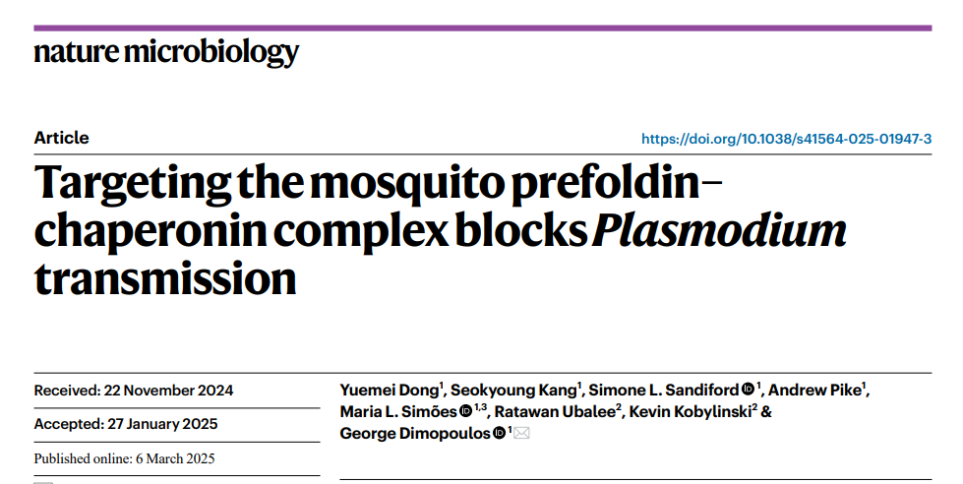
RESEARCH PAPER

Slide 32
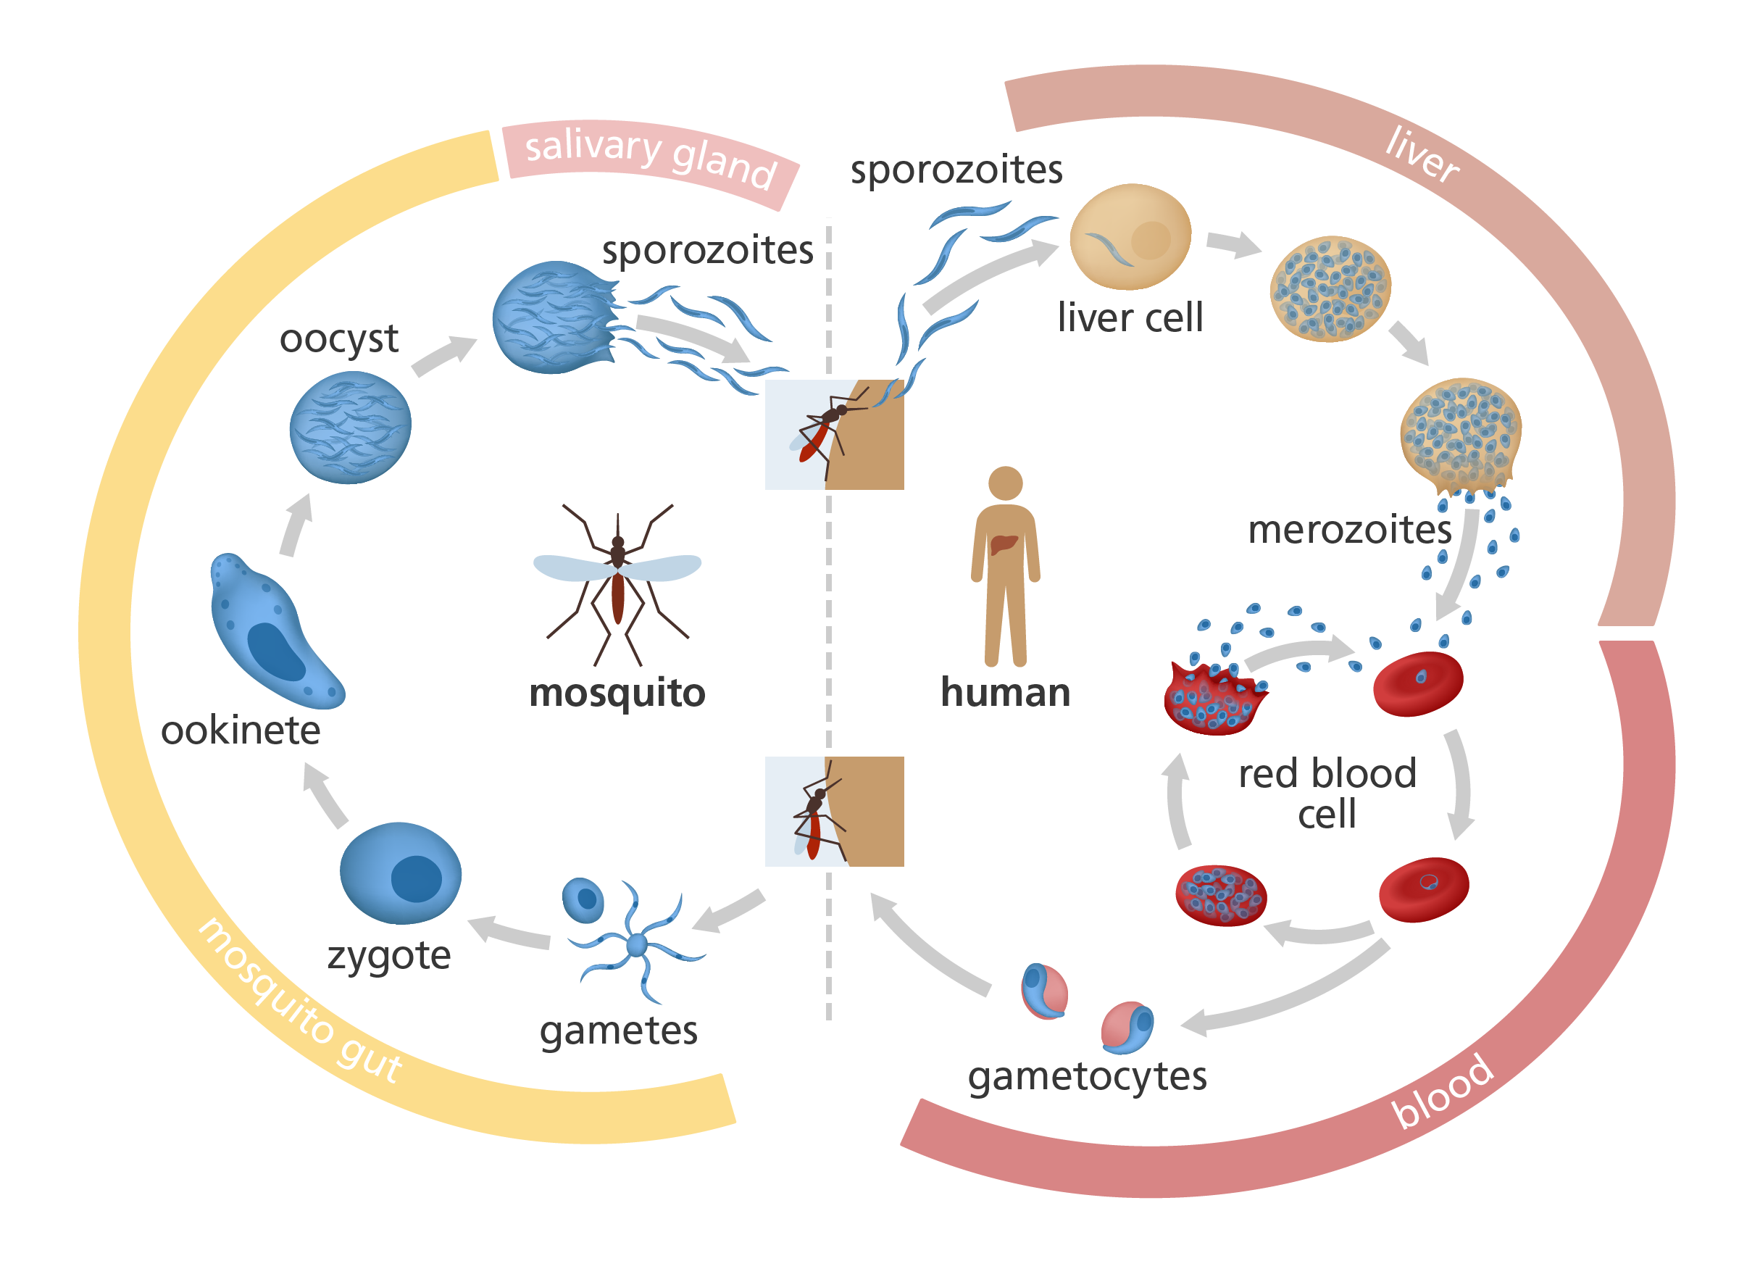
Malaria Life Cycle
Caused by parasite Plasmodium
Transmitted by Anopheles mosquitoes

Slide 33
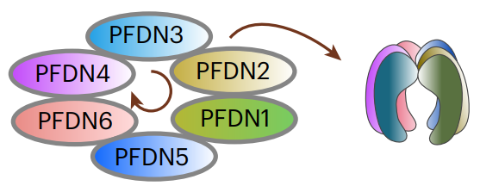
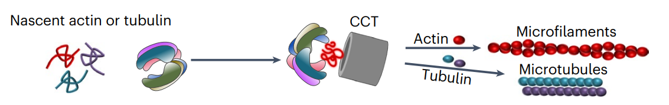
PFDN-CCT Complex
Alpha subunits
PFDN3
PFDN5
Beta subunits
PFDN1
PFDN2
PFDN4
PFDN6

Slide 34
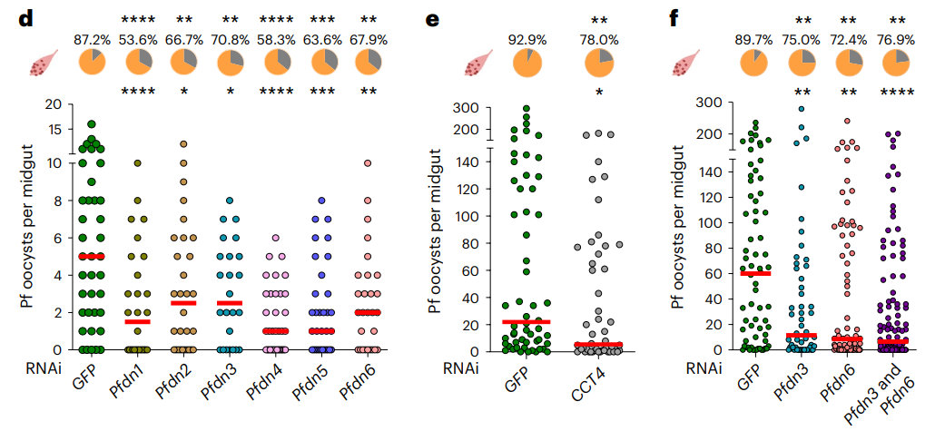
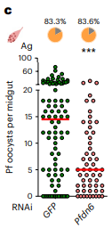
Why PFDN-CCT complex ?
Yeast two-hybrid screening
RNAi-based screening
Individual silencing of all six PFDN subunits and CCT subunit 4

Slide 35
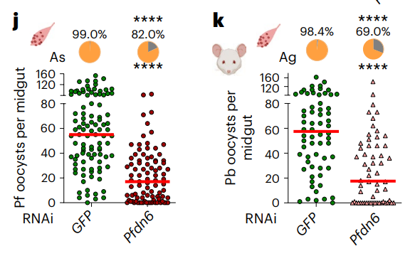
Why PFDN-CCT complex ?
Anopheles stephensi: Asian malaria vector
Plasmodium berghei :Rodent malaria parasite
Co-silencing of Pfdn3 with Pfdn6 showed no additive effect.

Slide 36
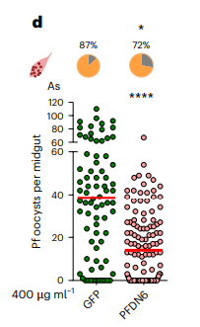
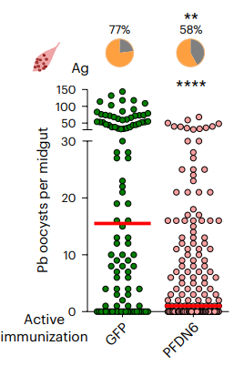
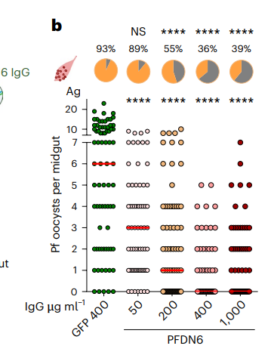
PFDN6 as TBV target
Dosage dependent intensity in A.Gambiae
A.Stephensi and P.Berghei

Slide 37
The PFDN–chaperonin complex is required for infection in diverse Anopheles–Plasmodium species combinations.

Slide 38
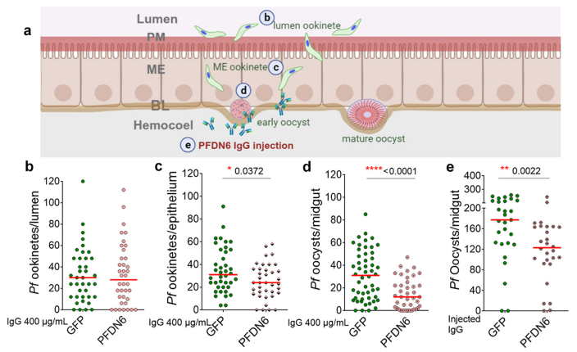
When does PFDN6 administer its host factor function?
Blocking activity of the antibody may be exerted on the basal region of the midgut epithelium.

Slide 39
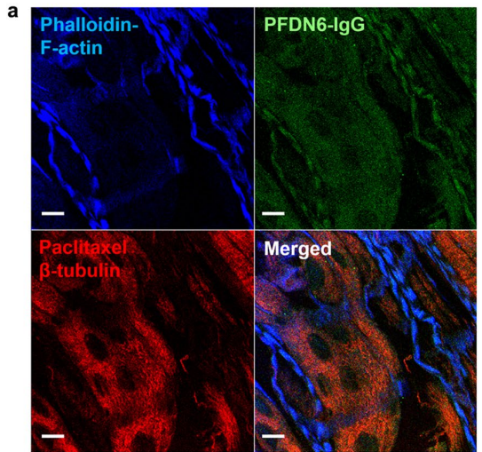
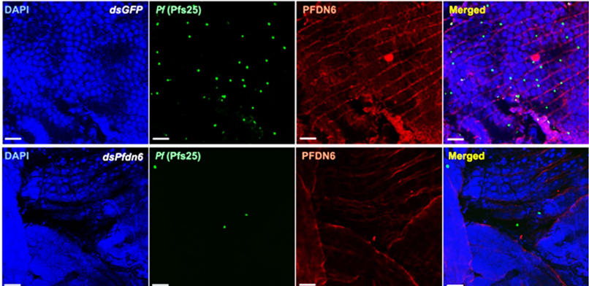
Is PFDN6 co-localized with the invading parasites in the midgut epithelium?

Slide 40
PFDN plays its host factor function for epithelium ookinete and early oocyst stages.

Slide 41
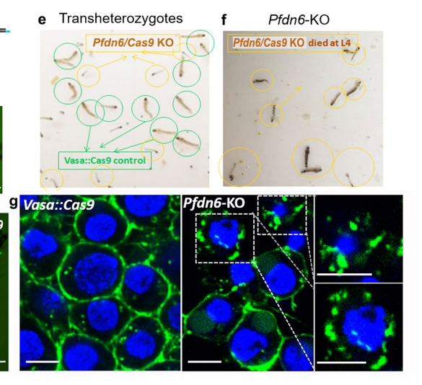
Generation of a CRISPR-Cas9-mediated gene knockout of the Pfdn6 gene

Slide 42
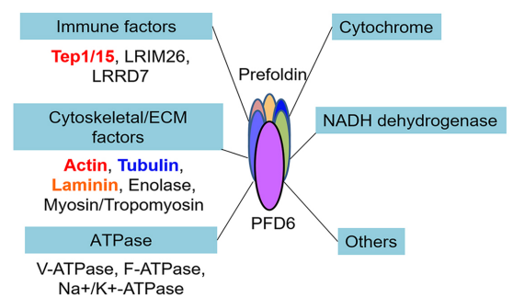
Co-immunoprecipitation (CoIP) analysis of PFDN6
Identified proteins interacting with PFDN6.
PFDN6

Slide 43
Disruption of the PFDN complex compromises the integrity of the midgut physical barrier and shortens the mosquito lifespan.

Slide 44
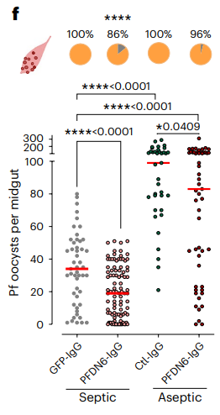
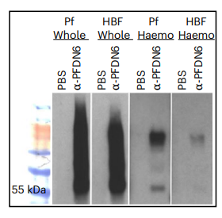
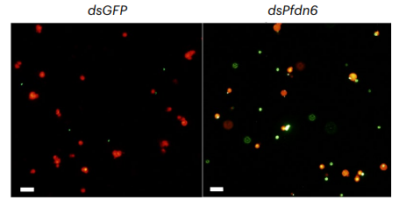
Infection-Triggered Midgut Barrier Breakdown and Microbial Leakage
8× higher phagocytic index in the Pfdn6-silenced mosquitoes.
Antibody diffusion is higher in infected mosquitoes.

Slide 45
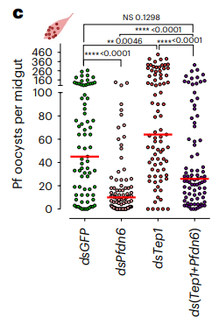
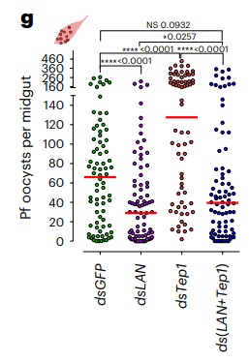
Gene Silencing: LAN and TEP1
LAN silencing alone → Decreased parasite survival due to lack of protection.
Tep1 silencing alone → Increased parasite survival due to reduced immune attack.

Slide 46
The microbial leakage upon midgut barrier disruption triggers anti-Plasmodium immune responses.

Slide 47
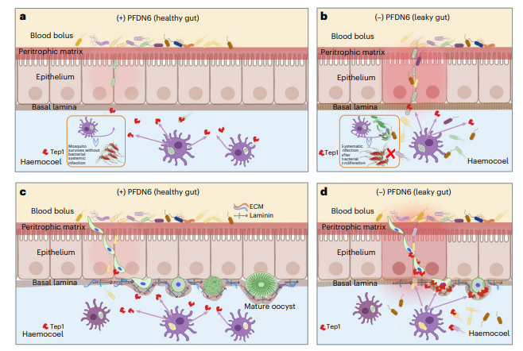
A proposed model of disruption of the PFDN–chaperonin complex

Slide 48
A diminished laminin coating upon PFDN– chaperonin complex disruption facilitates parasite targeting by the Tep1 complement factor.

Slide 49
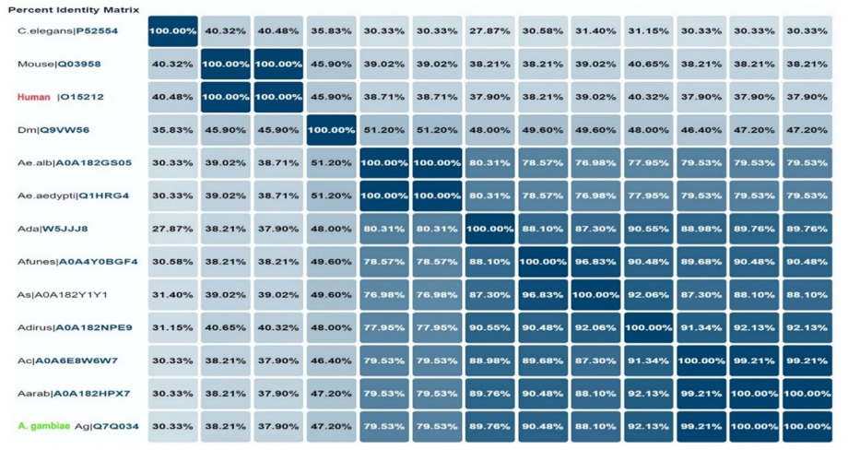
Protein sequence alignment of PFDN6

Slide 50
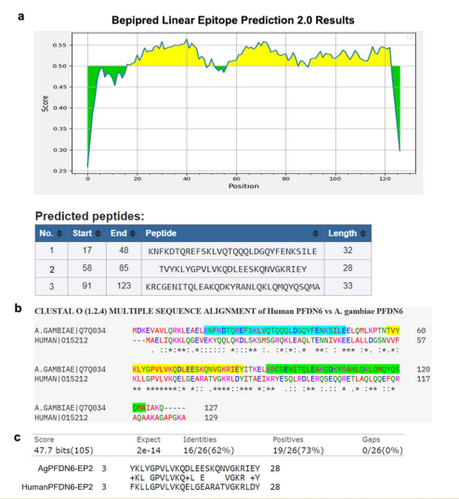
In silico prediction of antibody epitopes for AgPFDN6 and a comparison of sequence homology with human PFDN6
Epitope 3: 10/33 (30%) Identities and 13/33 (39%) Positives
Epitope 1 demonstrates no significant similarity.

Slide 51
Future Directions
Identifying mosquito-specific PFDN epitopes with low or no homology to human PFDN to reduce autoimmune risks.
Developing multivalent vaccines targeting multiple PFDN–CCT complex epitopes to increase efficacy and reduce resistance.
Exploring gene-drive strategies for conditional inactivation of the PFDN–CCT complex in mosquito populations.

Slide 52
Conclusion
PFDN–CCT as a TBV Target
Maintains midgut & basal lamina integrity.
Prevents microbiota leakage that triggers anti-Plasmodium immunity.
Supports parasite-protective laminin coating → limits immune attack.
Disruption exposes ookinetes to immune factors (e.g., Tep1).
Impacts mosquito health & lifespan via systemic bacterial infection.
Effective across P. falciparum, P. vivax, and multiple mosquito species.
Strong candidate for TBV development.

Slide 53
THANK YOU !

